Slide 1
Julius Caesar
Veni, Vidi, Vici

Slide 2
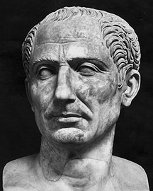
Who was Julius Caesar?
Born in 100 BC
Family was upper-class (patrician) but had little money.
A civil war left him penniless as a teenager
Joined the army at age 18 and worked his way up the career ladder
Becomes a general ruling over Spain by age 39
Elected consul and organizes a coalition with two important people: Pompey and Crassus

Slide 3
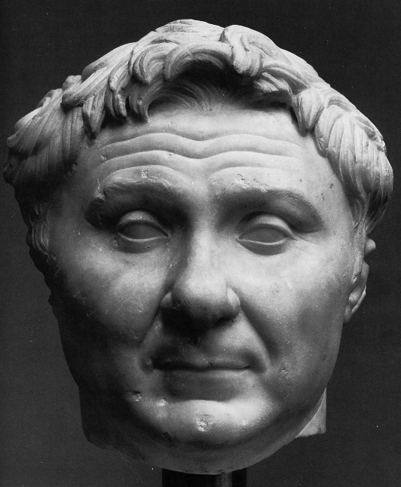
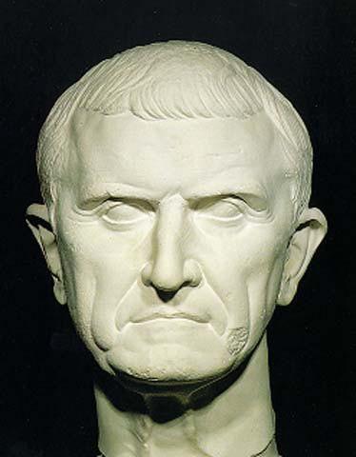
Who were Pompey and Crassus?
Pompey = Commander-in-chief of the military
Crassus = Wealthiest man in Rome. Think “Cra$$u$.”

Slide 4
How Did Caesar Seize Power?
Caesar shared power with Pompey and Crassus
In order to expand Roman power, Caesar conquered Gaul (modern-day France)
Conquering places brought in lots of revenue: gold, trade goods, and captives to be sold as slaves.
Caesar published a book about his victories.
This book basically made him a celebrity.

Slide 5
How Did Caesar Seize Power?
Crassus’ death changed everything.
The Roman senate convinced Pompey to go up against Caesar and take power for himself.
Caesar was ordered home to Rome and told that he had to leave his army behind.
Caesar was all, “No.”
Caesar, giving the entire “Leave your army behind” idea some major side-eye.

Slide 6
“The Die is Cast!”
Crassus’ death changed everything.
The Roman senate convinced Pompey to go up against Caesar and take power for himself.
Caesar was ordered home to Rome and told that he had to leave his army behind.
Caesar was all, “No.”
Caesar, giving the entire “Leave your army behind” idea some major side-eye.

Slide 7
“The Die is Cast!”
Caesar wrote to the Senate and said, “I’ll give up my army if Pompey will give up his.”
The Senate was pretty irritated with this idea.
They demanded he give up his army (which they could not legally do.)
Caesar’s move was to invade Italy by crossing the border, which was marked by the Rubicon River.
When he crossed, he famously said, “The die is cast,” meaning “I’ve made my move; there’s no turning back now.”

Slide 8
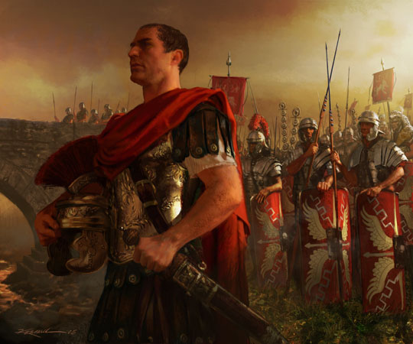
“The Die is Cast!”
That’s where we get the expression “to cross the Rubicon,” meaning, “to make a bold move you can’t go back on.”
Once Caesar crossed the Rubicon with his army, it was basically a declaration of war.

Slide 9
Defeating Pompey
Caesar quickly defeated the forces of Pompey.
Pompey fled to Egypt, where he was hoping for help.
The Egyptians were helpful…but not to Pompey.
The Eygptians figured Caesar would win, so in order to get in good with him, the Egyptians assassinated Pompey as soon as he arrived in their country

Slide 10
Caesar as Ruler
Caesar was now the undisputed ruler of Rome.
He was given the title of “Dictator,” which basically meant “Leader.”
Caesar does not give major side-eye to the idea of being dictator.

Slide 11
Caesar’s Changes
Caesar made significant changes in a relatively short period..
He increased votng rights for the people in some provinces.
(Unfortunately, this meant that now, new people had power. This was fine with them, but not fine with everyone else.)
He granted citizenship to many people, and again, that was a move that pleased those people, but angered those who had been in power before.
He also let more people become senators.

Slide 12
Angering the Senate
Caesar’s changes gave power to the people.
This meant that the Senate, the old, established power players in Rome, now had competition.
The Senate began to turn against Caesar, especially as he grew in power and was declared “Dictator Perpetuus,” or “Dictator for Life.”
Remember the story of Junius Brutus and the overthrow of the evil Tarquin?
Rome had declared that it wanted no more kings – but Caesar had basically all of the power of a king.
The Senate became more and more convinced that Caesar must die.

Slide 13
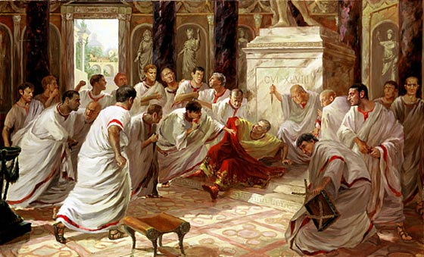
Lead-up to Assassination
A group of conspirators, led by the Roman senator Cassius and also by Brutus, one of Caesar’s most trusted friends and allies, plotted to eliminate Caesar.
They were afraid he would become a king and end the Roman republic.

Slide 14
Bad Omens
Caesar had a few hints that a devastating future might be in store for him.
A soothsayer (a fortuneteller) warned Caesar to “beware the Ides of March,” or to watch out for March 15.
According to Shakespeare, Caesar’s wife Calpurnia had a disturbing dream in which she saw a statue of Caesar suddenly begin to spout blood.
She urged him not to go to the Senate that day…but he went all the same.

Slide 15
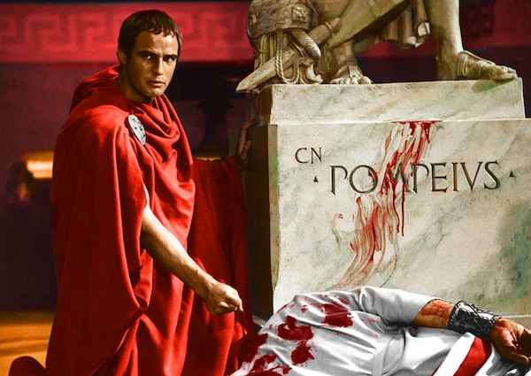
Assassination
The senators who were in on the conspiracy to kill Caesar gathered around him, and at an arranged signal, they stabbed him 23 times.
The last person to stab him was his friend Brutus.
According to legend, the last words Caesar spoke were, “Et tu, Bruté?” (“And you too, Brutus?”) as he saw in disbelief that his own best friend was in on the murder.

Slide 16
The Aftermath
The senators thought that the Roman people would be overjoyed to be rid of Caesar.
They thought the Roman people would greet them as liberators.
Instead, the reaction was unexpected.

Slide 17
The Aftermath, Continued
Remember, Caesar had given the regular Roman people much more power than they had enjoyed before.
He had given a greater number of people rights to vote and rights to serve in the Senate.
Additionally, he had given a decent share of money to the poor.

Slide 18
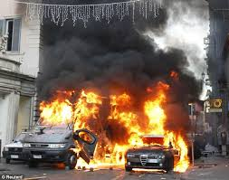
The Aftermath, Continued
That was a recipe for a riot.
Though Brutus tried to speak to the Roman people, he did not succeed in convincing them that the assassination had been for the public good.
The Senators also had no “end game” – that is, they had no plan covering the events after the assassination.

Slide 19
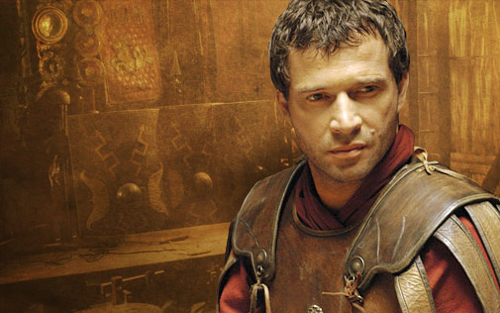
Marc Antony Turns the Tables
A major mistake the Senators made was in having Marc Antony, a loyal supporter of Caesar’s, speak at his funeral.
Antony read the Roman people Caesar’s will.
In the will, Caesar had given the people not only a great park, but a good chunk of money.
The Roman people were incensed at the Senators’ assassination of a man they now regarded as a hero.

Slide 20
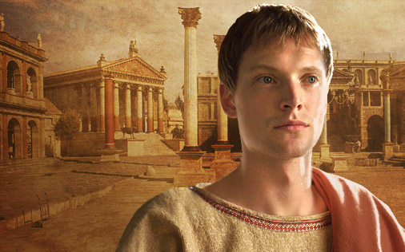
After Caesar…
Rome’s fate would ultimately be decided not by Brutus, whom people saw as an honorable (but misguided) man.
It would not be decided by the charismatic and power-hungry Antony.
Instead, Rome’s fate lay in the hands of a young man Caesar had – to everyone’s surprise – appointed as his heir: his great-nephew Octavian.

Slide 21
Octavian
Octavian was only 18 when Caesar unexpectedly made him the heir to the Roman Empire.
No one took it seriously – definitely not the powerful Marc Antony.
The only one who took it seriously was Octavian.

Slide 22
Octavian
Octavian was only 18 when Caesar unexpectedly made him the heir to the Roman Empire.
No one took it seriously – not the Senators, and definitely not the powerful Marc Antony.
The only one who took it seriously was Octavian.
Initially, Octavian forged a peace with Antony and another powerful man, Lepidus.

Slide 23
The SecondTriumvirate
Octavian was only 18 when Caesar unexpectedly made him the heir to the Roman Empire.
No one took it seriously – not the Senators, and definitely not the powerful Marc Antony.
The only one who took it seriously was Octavian.
Initially, Octavian forged a peace with Antony and another powerful man, Lepidus.
Together, they formed the Second Triumvirate. The Roman Empire would be ruled by these three men.

Slide 24
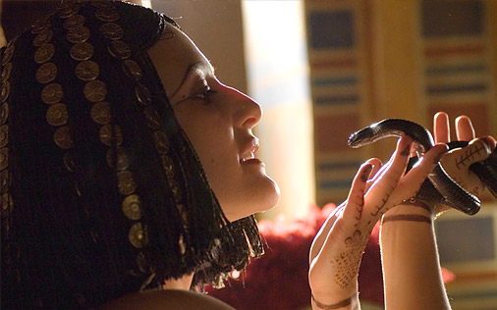
Octavian Becomes Augustus
Soon, the alliance began to split.
In a series of wars, Octavian conquered Antony and his powerful ally, the Egyptian queen Cleopatra.
Both Antony and Cleopatra committed suicide after their defeat: Antony threw himself on his own sword, and Cleopatra allowed herself to be bitten by a poisonous asp.

Slide 25
Octavian Becomes Augustus
The sole victor was Octavian, who would rule Rome for the next thirteen years.
In their efforts to prevent Rome from having a king, all that the conspirators had managed to do was set up Octavian as an emperor. Irony alert.
Octavian, who became known as Augustus, is still considered the best Roman emperor in history.
THE END

