Slide 1
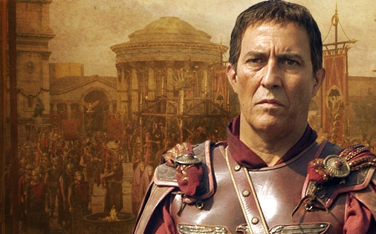
Julius Caesar

Slide 2
Bell Work
What do you know about the real Julius Caesar?
You will need to take notes (Cornell Style)

Slide 3
Early life
Born to the patrician family Julii in 100 B.C.
As a child, he would claim he was a descendent of the goddess Venus
Caesar’s father suddenly died and at age 16, Caesar became the head of the household
As a young man, Caesar was nominated for many important positions such as the Flamen Dialis
(High Priest of Jupiter)
He later joined the army, where he served with distinction.
He was later elected as military tribune and served in Hispania (modern day Spain).

Slide 4
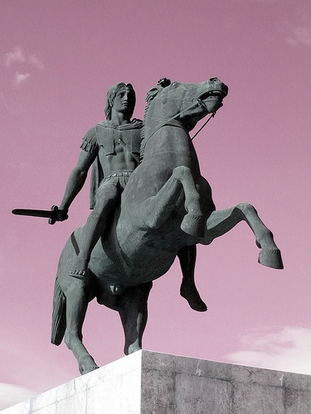
Rise to power
While in Hispania, Caesar (age 30) came across a statue of Alexander the Great and wept, for Alexander had conquered most of the known world by the same age and Caesar had accomplished so little.

Slide 5
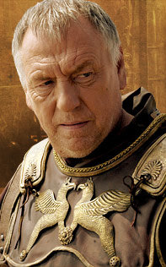
Rise to power
Caesar would continue to run for and hold many different political offices throughout the years.
After a successful governorship in Hispania and great military victories, Caesar was elected as consul, the most senior public office in the republic.
He would align himself with two other powerful men (Crassus and Pompey) in an informal alliance to create the First Triumvirate.
Caesar would even offer his own daughter, Julia, as a wife to Pompey to solidify their alliance.
Gnaius Pompey Magnus

Slide 6
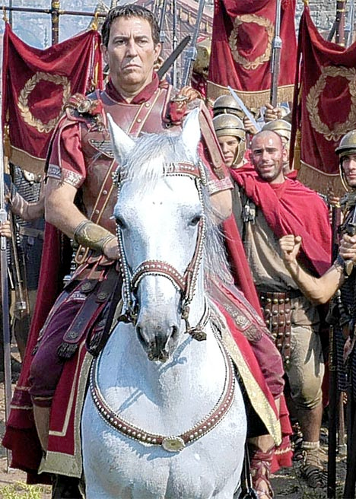
Military Might
Following his consulship, Caesar was deeply in debt. He took a governorship in the territory of Gaul (Northern Italy, Southern France, Germany, the Balkans).
There was much money in military adventuring and Caesar took advantage of this.
Gaul was unstable and bordered other unconquered territories.
Caesar proved to be a great military strategist and defeated tribal revolts and brought stability to Gaul while also conquering other lands.
Notable officers: Mark Antony, Marcus Junius Brutus

Slide 7
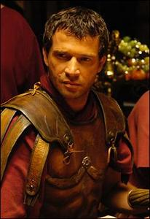
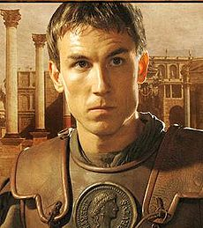
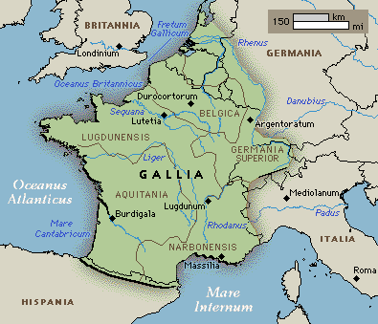
Military Might
Mark Antony
Marcus Junius Brutus
Gaul

Slide 8
Caesar’s Popularity Grows
Conquering was a very wealthy venture.
Caesar would conquer new people and new lands and would take the spoils of war.
Slaves, gold and other riches.
He would then send his riches back to Rome and his popularity among the people grew stronger.

Slide 9
The end of the First Triumvirate
While Caesar was away, Crassus dies leading an invasion of Parthia (Persia).
Pompey now becomes the sole consul back in Rome. (I.E. He runs the government!)
Julia, Caesar’s daughter and Pompey’s wife, dies during childbirth.
Pompey would then marry Cornelia, the daughter of Scipio, one of Caesar’s political rivals.
Pompey would then align himself with Scipio.
The Triumvirate was over.

Slide 10
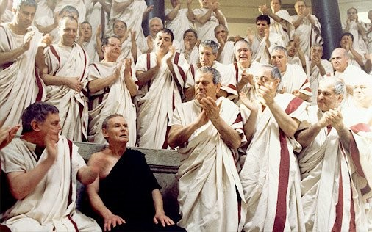
An Enemy of Rome
Many people believed that the ambitious Caesar was becoming too powerful.
The Senate ordered him to disband his army and return to Rome.
Caesar was wary of returning for he feared that he would be prosecuted or politically ostracized.
This refusal led Pompey to accuse Caesar of insubordination and the Senate declared Caesar a traitor and enemy of Rome.

Slide 11
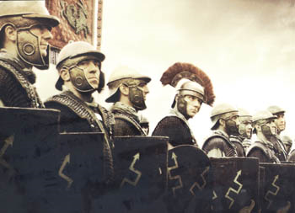
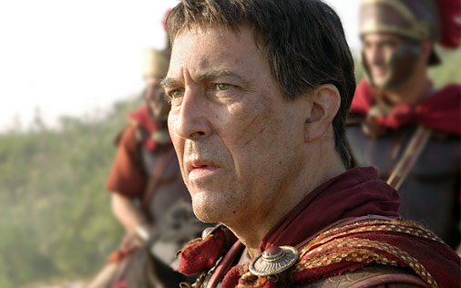
The Roman Civil War
Rome was split into followers of Pompey and those of Caesar.
Many of Caesar’s friends and allies, including Brutus, joined Pompey in opposition.
They felt Caesar was wrong to defy Rome.
On January 10th, 49 BC, Caesar crosses the Rubicon River, which marked the official boundary of Italy, with his best legion (Legio XIII - Gemina) and thus started the Roman Civil War.
Caesar would remark “Alea iacta est,” (the Die has been cast), continue his march towards Rome.

Slide 12
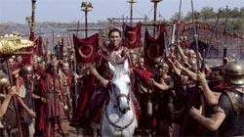
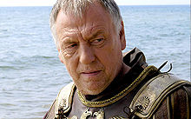
The Roman Civil War
Without a full army prepared for battle, Pompey and his followers would flee Rome.
The city was Caesar’s.
For 2 years, Caesar would pursue Pompey and his army throughout the region, constantly battling.

Slide 13
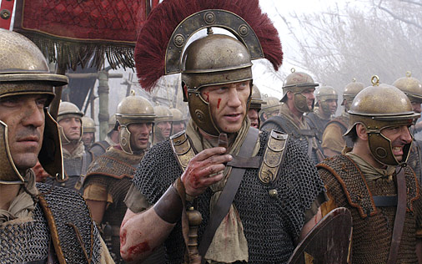
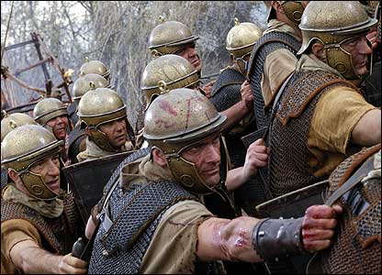
The Roman Civil War
Finally, at Pharsalus (Greece), Pompey surrounded and outnumbered Caesar. The odds were said to be 3 to 1.
Despite the grim odds, Caesar won the battle rather decisively and defeated Pompey and his followers once and for all.
However, Pompey would flee to Egypt, in hopes of raising another army.

Slide 14
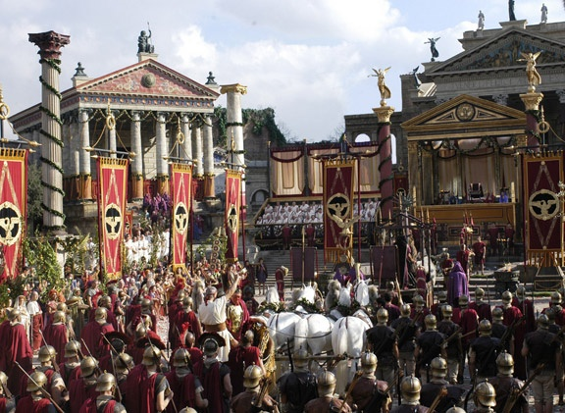
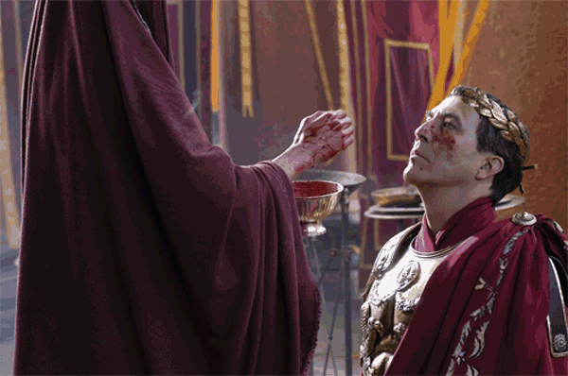
Return to Rome
Upon his return to Rome, Caesar would proclaim “Veni, Vidi, Vici”, or “I came, I saw, I conquered”.
The Romans would name Caesar a Dictator for 10 years.
Caesar made Mark Antony his 2nd in command.
Instead of taking revenge on those that opposed him during the Roman Civil War, Caesar actually pardoned and forgave them all, including Brutus.

Slide 15
Caesar as a Leader
Caesar would make many reforms as a leader.
He would not be the tyrant many had thought he would be but actually a man of the people (plebeians).
He would take care of his veteran soldiers by providing them with more money and land.
He made the people of conquered lands, official citizens of Rome.
He increased the Senate from 600 members to 900 to accommodate citizens from other lands.
He took steps to eliminate the debt of the people.
He reduced slavery to help decrease the unemployment rate.

Slide 16
Did You know?
One of Julius Caesar’s most significant reforms was the Roman calendar.
He overhauled the calendar by establishing a 365 day year (was formerly 355 days).
This aligned the months with the seasons more precisely.
The month of July is named in his honor.
MDCCLXXVI

Slide 17
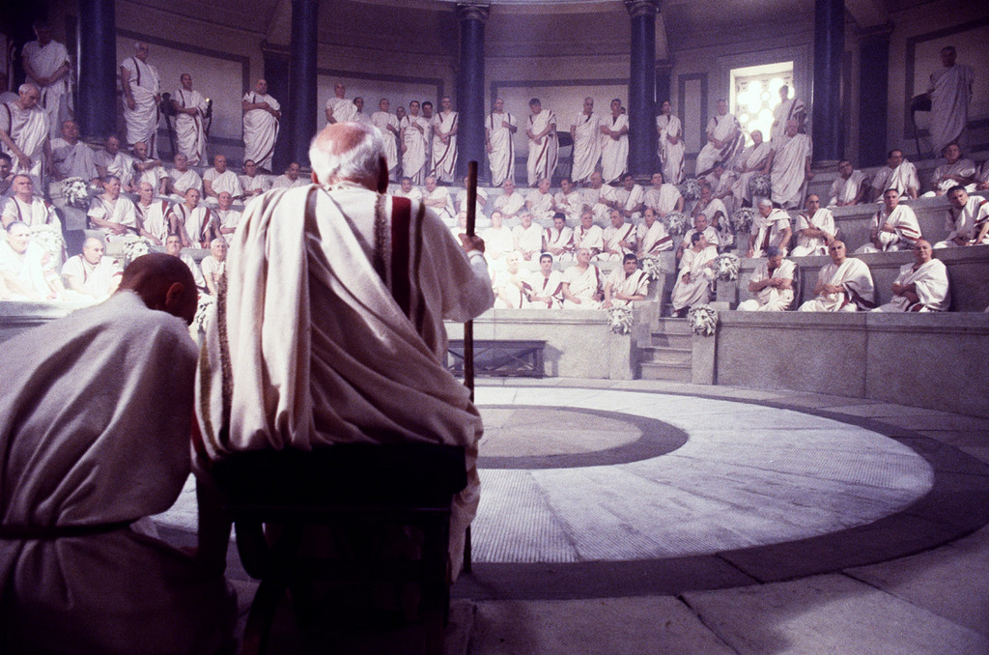
Assassination
Many of Caesar’s reforms were not popular among the Senate and other patricians.
Many still believed that Caesar was trying to become Imperator (emperor)
A group of Senators, led by Brutus, had a secret meeting and devised a plot to assassinate the dictator.

Slide 18
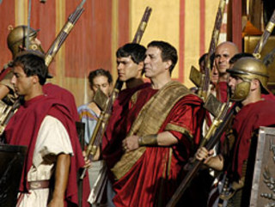
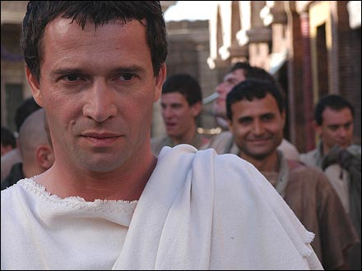
Assassination
On the Ides of March (March 15th) 44 BC, Caesar was called to the Senate chamber.
As usual he went with Antony at his side.
However, Antony was intercepted and distracted on the way to meet the Senate.

Slide 19
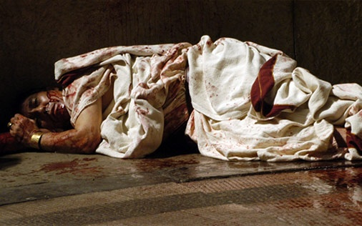
Assassination
Once in the Senate chamber, many Senators corralled around Caesar as if they had pressing business.
The attack commenced.
Senators grabbed Caesar while others thrust their knives into him.
After it was done, Caesar had been stabbed more than 20 times and lay in a pool of his own blood on the Senate floor
It was said that more than 60 Senators had participated in the violence.

Slide 20
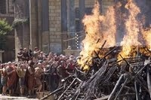
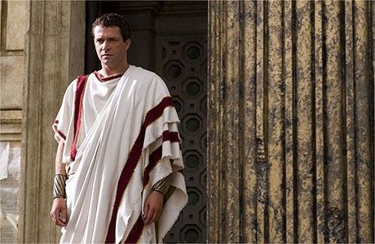
Aftermath
Many Roman citizens of the lower class, which Caesar was immensely popular with, were grief stricken.
Some even rioted and tried to set fire to the Senate house, angry that a few wealthy Senators would take it upon themselves to kill their champion
Antony would deliver a eulogy that would solidify Caesar’s popularity, posthumously.
Antony would also lead an army, hunting down and executing those involved in the assassination, including Brutus.

Slide 21
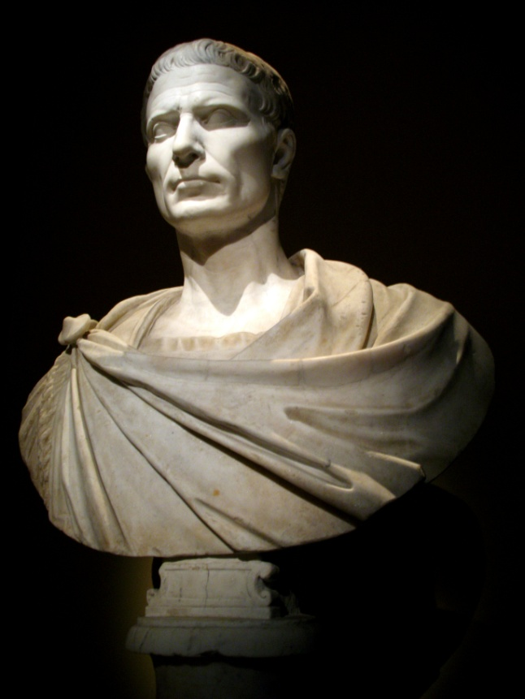
Closing Thought
Write down the three most interesting things you learned about Caesar and why you found them so interesting.

