Slide 1
The Odyssey
A Story of Homecoming, Hospitality, and Heroism

Slide 2
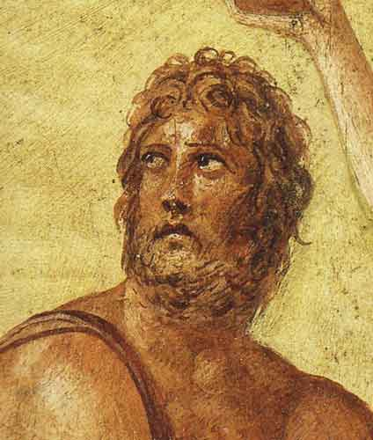
What is The Odyssey?
The Odyssey is an ancient Greek epic – an extended poem -- written by the poet Homer.
The Odyssey tells about the adventures of Odysseus, one of the greatest heroes of the Trojan War.

Slide 3
Initially, Odysseus didn’t wish to fight in the Trojan War.
When the messengers from the king arrived in Odysseus’ island of Ithaca to take him away for war, Odysseus faked insanity rather than leave his wife Penelope and their baby son Telemachus.

Slide 4
Unfortunately, the messenger figured out Odysseus wasn’t crazy, and Odysseus had to go to war.
For the next ten years, Odysseus would be away with the Greek army, fighting before the city of Troy.

Slide 5
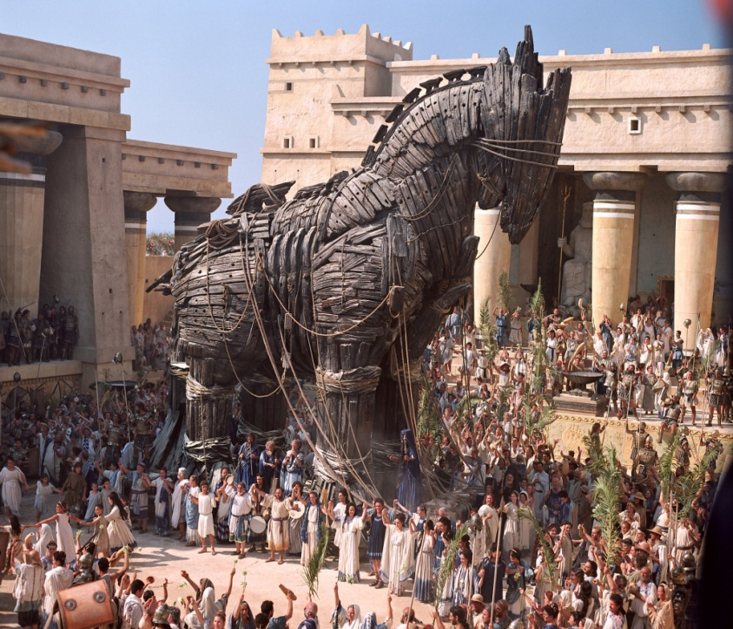
The Trojan Horse
The Greeks finally won the Trojan War, thanks to Odysseus’ idea to conceal Greek soldiers inside a hollow wooden horse.
Thinking the Greeks had given up and gone home, the Trojans carried the horse into the city, not knowing that this decision would destroy them.

Slide 6
Destruction of Troy
The Greek soldiers waited until the Trojans were asleep, then sneaked out, opened the city gates to the Greek soldiers waiting outside, and set Troy on fire.

Slide 7
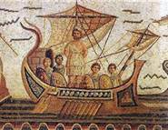
Odysseus’ Homecoming
By this time, Odysseus desperately wanted to sail for home.
The story of the Odyssey is the story of Odysseus’ journey home and the trials he encountered on the way.
Not surprisingly, one of the major ideas of this epic is the theme of nostos, or homecoming.

Slide 8
Odysseus’ Troubles
…but coming home wasn’t going to be so easy.
Odysseus’ journey home took him ten long years.
Odysseus’ own actions were partly to blame.

Slide 9
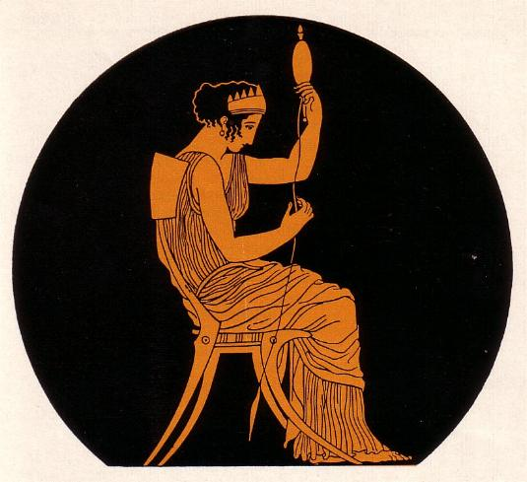
The Structure of the Epic
The Odyssey doesn’t tell its story in a straight chronological order.
Instead, when we first begin the epic, we aren’t even introduced to Odysseus at first.
Instead, we see the situation at home in Ithaca, Odysseus’ island kingdom, and meet his wife Penelope .

Slide 10
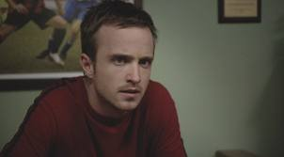
The Telemachy – First Four Books
We also meet Odysseus’ son Telemachus.
Telemachus, who has not seen his father in years, is almost a man by the time the epic begins.
He is occasionally impulsive and eager to prove himself as his father’s son.
The first four books, called the ”Telemachy,” are about Telemachus’ efforts to find Odysseus or at least learn what happened to him after the war.

Slide 11
Telemachy – The First Four Books
Telemachus was forced to grow up quickly due to a problematic situation at home.
His father had been gone for a long time, and most people thought Odysseus was probably dead.
When there’s a rich island kingdom and no leader, the situation gets dicey.

Slide 12
Those Darned Suitors
Faithful Penelope, Odysseus’ wife, had been hounded by a group of men, suitors for her hand in marriage.
They only wanted Odysseus’ land and power.
They would probably kill her son Telemachus because he was a rival to them.
Still, as the queen of the island, she was forced to show them courtesy and hospitality.

Slide 13
Major Theme: Xenia, or Hospitality
The idea of xenia, or hospitality, was an important one in ancient Greece, and it’s an important idea in this epic.
Xenia means the proper conduct of a host to a guest (and a guest to a host).
Hosts are supposed to offer guests food, shelter, and assistance without getting all nosy about their guests’ business.
(After all, a guest could be a god in disguise, so…you’d better break out the nice towels for Zeus, am I right?)

Slide 14
Major Theme: Xenia, or Hospitality
Throughout this epic, we will see people break these rules of xenia – usually with pretty serious consequences.
(By the way, the suitors are totally breaking the rules of hospitality. They’re the Guests That Would Not Leave, or even worse, the Guests That Will Probably Kill Your Son.)

Slide 15
Nostos: The Quest for Home
When the epic begins, Odysseus had been gone from Ithaca for twenty years.
Telemachus finds out that everyone else from the Trojan War was already accounted for except for Odysseus.
What was taking Odysseus so long to come home?

Slide 16
Nostos: The Quest for Home
In books 5-6, the readers learn what’s been keeping Odysseus from home: the nymph Calypso.
She is in love with Odysseus, but all Odysseus does is pine for home.
Finally, the gods have to step in and say, “It’s not you. It’s him. Let him go.”

Slide 17
Nostos: The Quest for Home
In books 5-6, the readers learn what’s been keeping Odysseus from home: the nymph Calypso.
She is in love with Odysseus, but all Odysseus does is pine for home.
Finally, the gods have to step in and say, “It’s not you. It’s him. Let him go.”

Slide 18
Nostos: The Quest for Home
She’s kept Odysseus captive for seven years.
By that time, Odysseus is pining for home, an idea that introduces another major idea of this epic: the idea of nostos, or homecoming.
(This is the root of our word nostalgia, or the longing to go back to our home.)

Slide 19
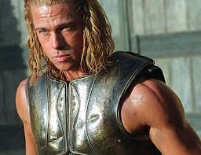
Nostos versus Kleos: Home versus Fame
Throughout the epic (and the “prequel” epic known as the Iliad), the idea of nostos is often pitted against the desire for kleos, or fame.
Achilles, the greatest warrior of the Greeks, was offered a choice between nostos and kleos.

Slide 20
Nostos versus Kleos: Home versus Fame
Achilles could choose his own fate, but there were only two choices.
He could either choose a long and happy life or a short and brutal one.
The catch? If he lived the long and happy life, no one would remember him for very long.
If he lived the short and brutal life, Achilles would achieve kleos aphthiton, or fame undying. Achilles would be famous forever.

Slide 21
Nostos versus Kleos: Home versus Fame
If you want to know which fate Achilles chose, think about the fact that even though the Trojan War took place over three thousand years ago, we are STILL talking about this dude.
(Yeah, he chose kleos aphthiton.)

Slide 22
Nostos: Odysseus’ Choice
As you can probably tell, Odysseus chose nostos, or homecoming…but it wasn’t easy.
After escaping from Calypso, Odysseus washes up naked and alone on the island of Ischeria, where he finally tells his tale to the king of the island.
Books 9-12 are the “epic digression,” or a flashback about what happened when Odysseus left Troy.

Slide 23
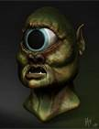
The Trouble with the Cyclops
One of the major reasons Odysseus had trouble getting home was because of this attractive fellow, the Cyclops.
The Cyclopes were sons of the sea god Poseidon.
They were enormous giants with one great eye in the middle of their foreheads.
They also had a taste for human flesh.

Slide 24
Odysseus Makes an Enemy
When Odysseus and his men were trapped by the Cyclops in his cave, clever Odysseus figured a way out.
Odysseus also blinded the Cyclops and helped his fellow Greeks escape.

Slide 25
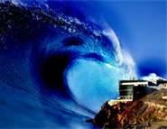
Poseidon Vows Revenge
However, Odysseus couldn’t risk bragging about his deeds.
Not surprisingly, the news of Odysseus’ treatment of the Cyclops got back to Poseidon, the Cyclopes’ father.
Note to Odysseus: If you’re sailing home toward your island kingdom, you should try very, very hard not to anger the god of the sea.

Slide 26
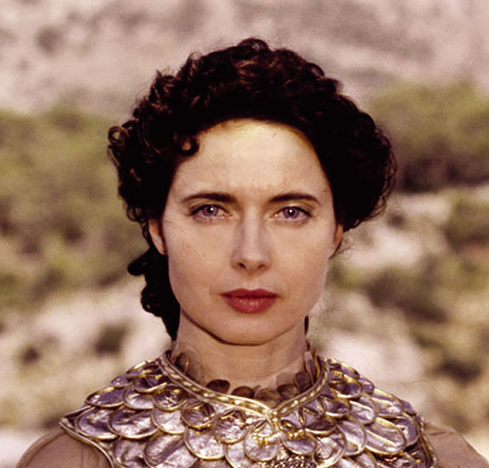
Odysseus Makes Friends
Odysseus had made an enemy of the god Poseison, but he made a friend in an equally powerful deity, the goddess Athena.

Slide 27
Athena + Odysseus = BFFs
Athena, the goddess of war and wisdom, saw that Odysseus, with his cleverness and cunning, was a lot like herself.

Slide 28
Athena Lends a Hand
Athena vowed to help Odysseus get home to his wife, the faithful Penelope, and to his son Telemachus.
Athena could not stop Poseidon from messing with Odysseus, but she could level the playing field.
Athena would help Odysseus many times with her wise advice.

Slide 29
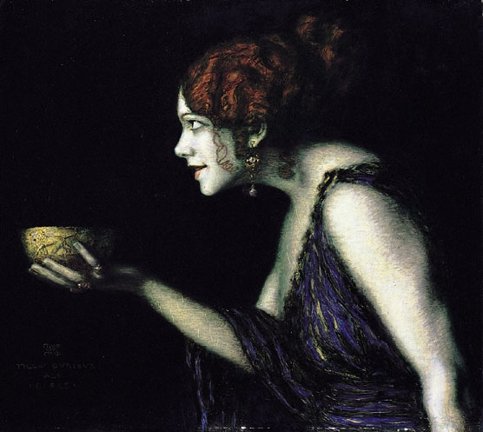
Odysseus’ Temptations and Trials
Even with Athena’s help, it took Odysseus ten years to get home.
Odysseus explains to the king of Scheria that along the way, he faced many temptations and trials.
For example, when he and his soldiers arrived on the island of the witch Circe, Circe turned Odysseus’ men into animals.

Slide 30
The Land of the Dead
After convincing Circe to turn his men back to human form, Odysseus asked Circe how to get home.
Basically saying, “I’m not Google Maps,” Circe told Odysseus to seek advice from the wisest of men: the prophet Tiresias.
The only problem? Tiresias was dead.

Slide 31
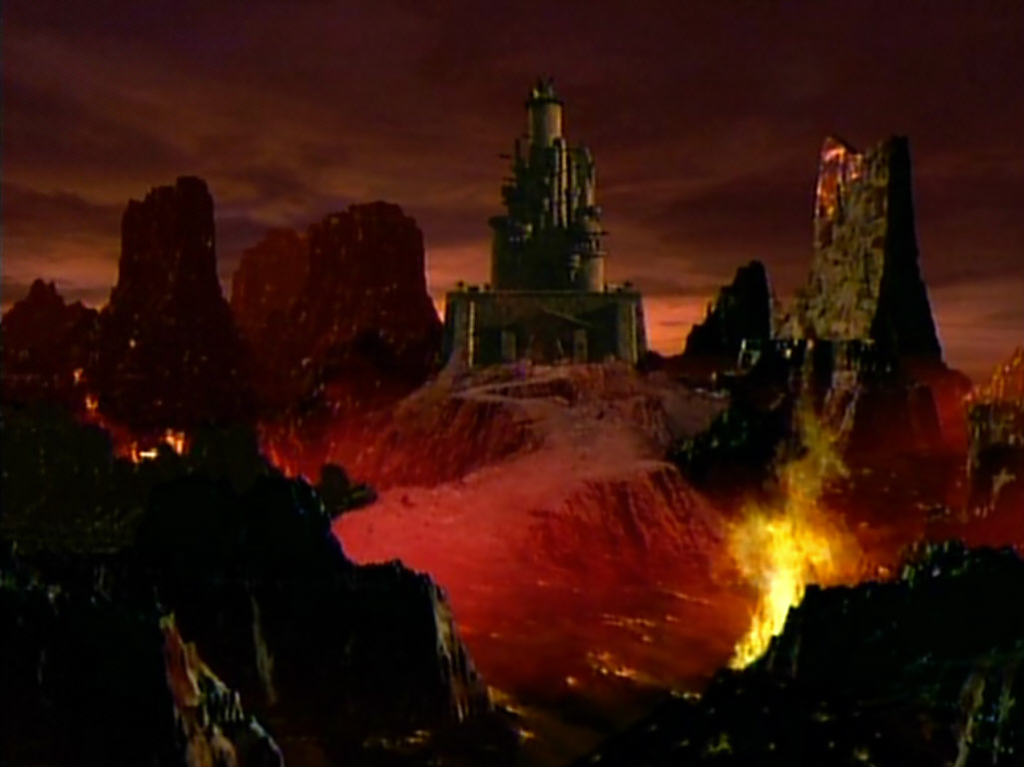
The Land of the Dead
Odysseus’ solution: Go to the Underworld, the land of the dead, and speak to the ancient prophet Tiresias in order to find his way home.

Slide 32
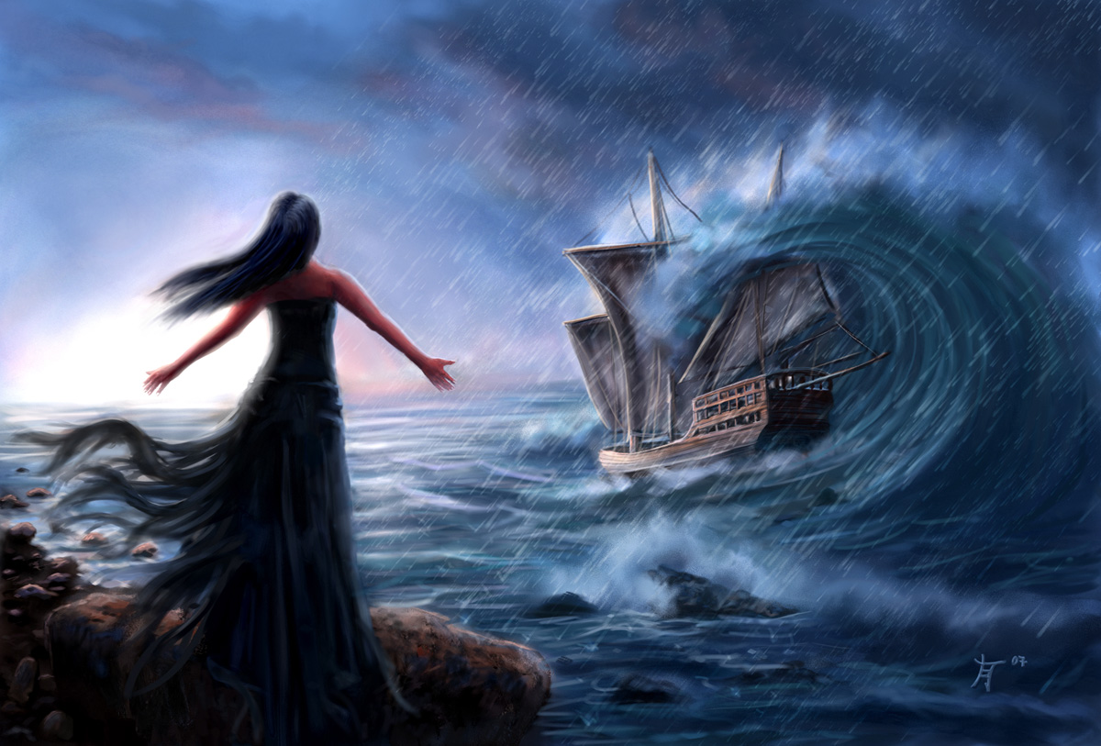
The Monsters of the Sea
Odysseus continues his story to the king of Scheria, explaining that after leaving Circe’s island, he knew he would have to face many challenges.
The first challenge: Sail past the island of the Sirens.

Slide 33
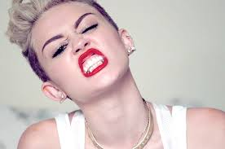
Siren Song
The Sirens were beautiful…but deadly.
Their song lured sailors to their doom.
Hearing the song, the sailors were hypnotized.
They would jump overboard to hear the song more closely and be crushed to death on the rocks of the Sirens’ island.

Slide 34
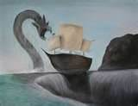
Caught Between Scylla and Charybdis
Odysseus then tells the king of Scheria about his next challenge: to sail his ship between the whirlpool named Charybdis…
…and a many-tentacled monster named Scylla.

Slide 35
Odysseus Alone Survives
Odysseus’ cleverness and his obedience to the Gods allowed him to live…
….but he was the only one of his men to make it back alive from all the dangers.
This leads to yet another one of the epic’s concerns: What qualities are necessary in a good leader?

Slide 36
Nostos At Last : Odysseus Makes it Home
Odysseus could now arrive home.
His faithful wife Penelope, true to her husband’s name and memory, had preserved Odysseus’ kingdom of Ithaca…but as you will recall, it had not been easy.

Slide 37
Clever Penelope
Penelope was surrounded by suitors who just wanted Odysseus’ land and power.
Wisely, Penelope played a waiting game.
If Penelope could keep the suitors at bay and stall for awhile, maybe Odysseus would come home.
Still, as the queen of the island, Penelope was forced to show the suitors courtesy and hospitality.

Slide 38
Penelope’s Trick
Finally, the suitors became more and more impatient and destructive.
The suitors, especially the lead suitor Antinous, kept insisting Penelope choose one of them.
Penelope said, “Wait until I’m done with my weaving, and then I’ll marry one of you.”

Slide 39
Penelope’s Trick
However, every night when the suitors were asleep, Penelope un-wove the work she had done that day.
(This made the weaving take forever to be completed.)

Slide 40
Penelope in a Bind
Soon, the suitors figured out Penelope’s ruse.
Penelope was running out of options.
After dealing with more of Poseidon’s cruelty on the way from Scheria, Odysseus was barely recognizable when he landed on the island.
This issue is central to another of the epic’s themes: identity.
(In fact, one of the only characters to recognize Odysseus at first is his beloved dog.)

Slide 41
Odysseus’ Revenge
Odysseus wanted Penelope to keep quiet about his presence.
He was one man alone.
The suitors, by contrast, had many soldiers and followers.
Odysseus knew that if he revealed himself, the suitors would just kill him, kill murder his son Telemachus, and take Ithaca and Penelope for their own.

Slide 42
Athena Helps
Penelope, with the help of Athena, proposed a contest for the suitors.
Penelope offered this challenge: Whoever could string Odysseus’ great bow and shoot an arrow through twelve axe heads could have her and the kingdom.

Slide 43
Odysseus’ Disguise
Disguised as a beggar, Odysseus observed the suitors’ contest.
No one, not even the powerful Antinous, could string the bow – it was a task too powerful for anyone but Odysseus.
When the “beggar” asked to participate in the contest, the suitors mocked him.

Slide 44
Odysseus Claims His Home
With ease, the “beggar” Odysseus strings his bow and shoots the arrow through the axes.
The disguise falls away and the suitors realize Odysseus is truly home.
That is the last thing they will ever realize.
Odysseus and Telemachus have made sure the suitors will never leave the island.

Slide 45
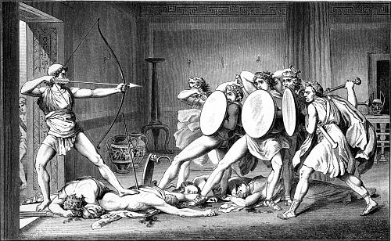
Odysseus and Telemachus
Together, Odysseus and his son Telemachus turn their arrows on the suitors who have overrun their kingdom.
Odysseus can now rest from his travel. He has achieved his nostos, his homecoming.

Slide 46
RECAP
Four main parts to the epic:
Books 1-4: The Telemachy
Books 5-8: Escape from Calypso/Arrival on Scheria
Books 9-12: Epic Digression
Books 13-24: Odysseus Arrives Home

Slide 47
RECAP
Four main thematic concerns in the epic:
Xenia, or Hospitality
Nostos, or Homecoming
Kleos, or Fame
The Nature of Leadership

